Slide 1
Unit 1
Introduction to Wireless Communication Systems
WEEK 1 : Introduction to wireless communication and mobile radio communication, Classification of wireless communications - simplex, half duplex, dull duplex, Paging and Cordless systems, Cellular telephone systems, Timing diagram - landline to mobile and mobile to mobile, Basic antenna parameters, Far field and near field
WEEK 2 : Frequency reuse, sectored and omni- directional antennas, Channel assignment strategies, Handoff and its types, Interference and system capacity
WEEK 3 : Trunking and Grade of Service, Cell splitting, Sectoring, Microcell zone concepts, Umbrella cells, Solving Problems
These slides contains copyrighted materials from - Wireless Communications: Principles and Practice, Theodore S. Rappaport, and antenna concepts – Constantine A Balanis used as instructor resources.
Text books, references:
Rappaport T.S, “Wireless Communications: Principles and Practice”, Pearson education.
For antenna concepts - Constantine Balanis. A, “Antenna Theory: Analysis and Design”, 3rd Edition, John Wiley, 2012.

Slide 2
WEEK 1 LECTURES
Overview - Evolution of wireless communication, mobile radio communication antenna basic and Cellular concepts
Syllabus Coverage :
Introduction to wireless communication and mobile radio communication, Classification of wireless communications - simplex, half duplex, dull duplex, Paging and Cordless systems, Cellular telephone systems, Timing diagram - landline to mobile and mobile to mobile, Basic antenna parameters, Far field and near field
Courtesy:
Rappaport T.S, “Wireless Communications: Principles and Practice”, Pearson education.

Slide 3
What is Wireless Communication?
Transmitting/receiving voice and data using electromagnetic waves in free space.
The information from sender to receiver is carried over a well defined frequency band (channel).
Each channel has a fixed frequency bandwidth and capacity (bit rate).
Different channels can be used to transmit information in parallel and independently.

Slide 4
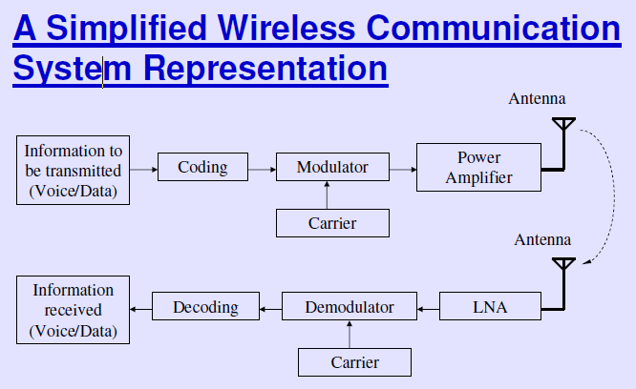
Source : NPTEL Wireless lecture – Dr. Ranjan Bose (slide 28)

Slide 5
Example
Assume a spectrum of 120 kHz is allocated over a base frequency for communication between stations A and B.
Each channel occupies 40 kHz.
Station A | Channel 1 (b to b+40) | Station B
 | Channel 2 (b+40 to b+80)
 | Channel 3 (b+80 to b+120)

Slide 6
Can we allocate spectrum like that ?
No, its Idealized
What can we do then?
Guard Bands
How do you determine the width of the Guard band?
Depends upon how sharp your receiver filter roll off factor is !

Slide 7
Types of Wireless Communication
Mobile
Cellular Phones (GSM/ CDMA)
Portable
IEEE 802.11b (Wi-Fi)
IEEE 802.15.3 (UWB)
Fixed
IEEE 802.16 (Wireless MAN)

Slide 8
Typical Frequencies
FM Radio ~ 88 MHz
TV Broadcast ~ 200 MHz
GSM Phones ~ 900 MHz
GPS ~ 1.2 GHz
Bluetooth ~ 2.4 GHz
WiFi ~ 2.4 GHz

Slide 9
Why Wireless?
Benefits
Mobility: Ability to communicate anywhere!!
Easier configuration, set up and lower installation cost
Difficulties
Communication medium: Free space
Noisy and unpredictable channel
Broadcast channel, more user ->less BW per user
Higher equipment cost
Usually regulated spectrum and limited BW
Techno-politic
Need backbone systems in order to function properly

Slide 10
Challenges
Efficient Hardware
Low power transmitters, receivers
Low power signal processing tools
Efficient use of finite radio spectrum
Cellular frequency reuse, medium access control protocols
Integrated Services
Voice, data, multimedia over the same network
Service differentiation, priorities, resource sharing

Slide 11
Challenges
Network support for user mobility (mobile scenarios)
Location identification, Handoffs,..
Maintaining quality of service over unreliable links.
Connectivity and coverage (internetworking)
Cost efficiency

Slide 12
Challenges
Fading
Multipath
Higher probability of data corruption
Hence, need for stronger channel codes
Need for stronger security mechanisms
Privacy, Authentication.

Slide 13
Evolution of Mobile Radio Communications
Major Mobile Radio Systems
1934 - Police Radio uses conventional AM mobile communication system.
1935 - Edwin Armstrong demonstrate FM
1946 - First public mobile telephone service - push-to-talk
1960 - Improved Mobile Telephone Service, IMTS - full duplex
1960 - Bell Lab introduce the concept of Cellular mobile system
1968 - AT&T propose the concept of Cellular mobile system to FCC.
1976 - Bell Mobile Phone service, poor service due to call blocking
1983 - Advanced Mobile Phone System (AMPS), FDMA, FM
1991 - Global System for Mobile (GSM), TDMA, GMSK
1991 - U.S. Digital Cellular (USDC) IS-54, TDMA, DQPSK
1993 - IS-95, CDMA, QPSK, BPSK

Slide 14
Example of Mobile Radio Systems
Examples
Cordless phone
Remote controller
Hand-held walkie-talkies
Pagers
Cellular telephone
Wireless LAN
Mobile - any radio terminal that could be moves during operation
Portable - hand-held and used at walking speed
Subscriber - mobile or portable user

Slide 15
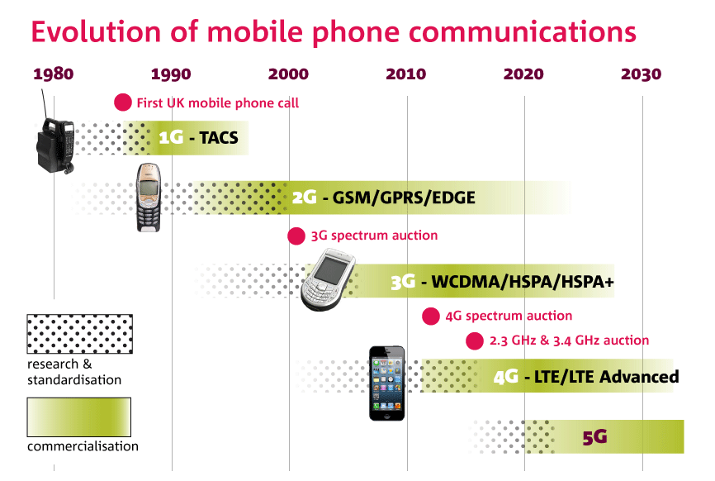

Slide 16
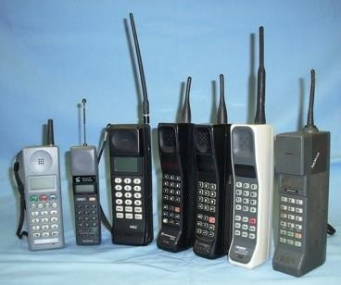
1G
From 1980 to 1990
Bad voice quality
Poor battery, cellphones
Big cellphones
Better than nothing, at least its wireless and mobile
Frequency: 150MHz / 900MHz
Bandwidth: Analog telecommunication (30KHz)
Characteristic: First wireless communication
Technology: Analog cellular
Capacity (data rate): 2kbps

Slide 17
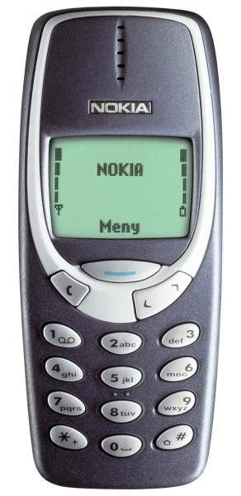
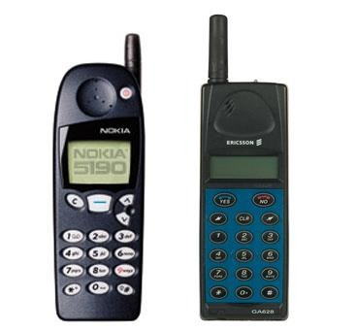
2G
Frequency: 1.8GHz (900MHz), digital telecommunication
Bandwidth: 900MHz (25MHz)
Characteristic: Digital
Technology: Digital cellular, GSM
Capacity (data rate): 64kbps
Why better than 1G?
From 1991 to 2000
Allows txt msg service
Signal must be strong or else weak digital signal
2.5G
2G cellular technology with
GPRS
E-Mails
Web browsing
Camera phones

Slide 18
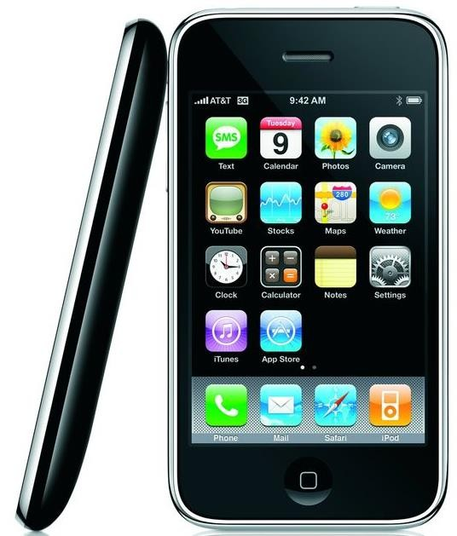
3G
Frequency: 1.6 – 2.0 GHz
Bandwidth: 100MHz
Characteristic: Digital broadband, increased speed
Technology: CDMA, UMTS, EDGE
Capacity (data rate): 144kbps – 2Mbps
Why better than 2G?
From 2000 to 2010
Called smartphones
Video calls
Fast communication
Mobil TV
3G phones rather expensive

Slide 19
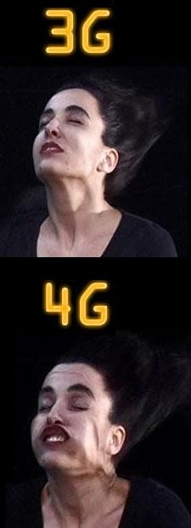
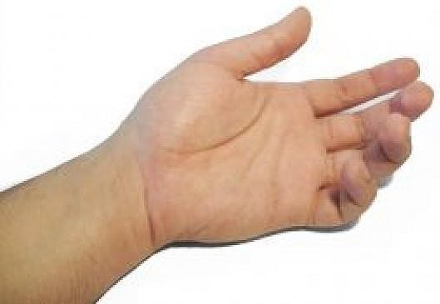
4G
Frequency: 2 – 8 GHz
Bandwidth: 100MHz
Characteristic: High speed, all IP
Technology: LTE, WiFi
Capacity (data rate): 100Mbps – 1Gbps
Why better than 3G?
From 2010 to today (2020?)
MAGIC
Mobile multimedia
Anytime, anywhere
Global mobile support
Integrated wireless
solutions
Customized personal service
Good QoS + high security
Bigger battery usage

Slide 20
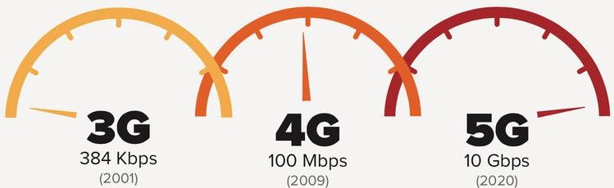
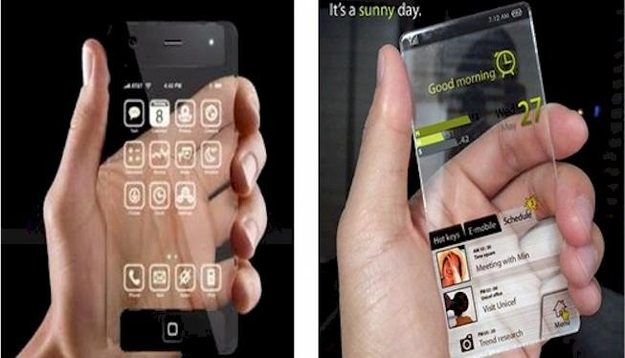
5G
https://5g.co.uk/guides
/5g-frequencies-in-the- uk-what-you-need-to- know/
Capacity (data rate): 1Gbps – ULIMITED?
Why better than 4G?
From X (2020?) to Y (2030?)
High speed and capacity
Faster data trasmission than 4G
Supports
Interactive multimedia
Voice streaming
Buckle up.. Internett
More efficient

Slide 21


Comparison
1G, 2G, 3G, 4G, 5G
 | 1G | 2G | 3G | 4G | 5G
Period | 1980 – 1990 | 1990 – 2000 | 2000 – 2010 | 2010 – (2020) | (2020 - 2030)
Bandwidth | 150/900MHz | 900MHz | 100MHz | 100MHz | 1000x BW pr unit area
Frequency | Analog signal (30 KHz) | 1.8GHz (digital) | 1.6 – 2.0 GHz | 2 – 8 GHz | 3 – 300 GHz
Data rate | 2kbps | 64kbps | 144kbps – 2Mbps | 100Mbps – 1Gbps | 1Gbps <
Characteristic | First wireless communicatio n | Digital | Digital broadband, increased speed | High speed, all IP
Technology | Analog cellular | Digital cellular (GSM) | CDMA, UMTS, EDGE | LTE, WiFi | WWWW
https://www.lin kedin.com/puls e/evolution- mobile- communication
-from-1g-4g-5g- 6g-7g-pmp-cfps

Slide 22
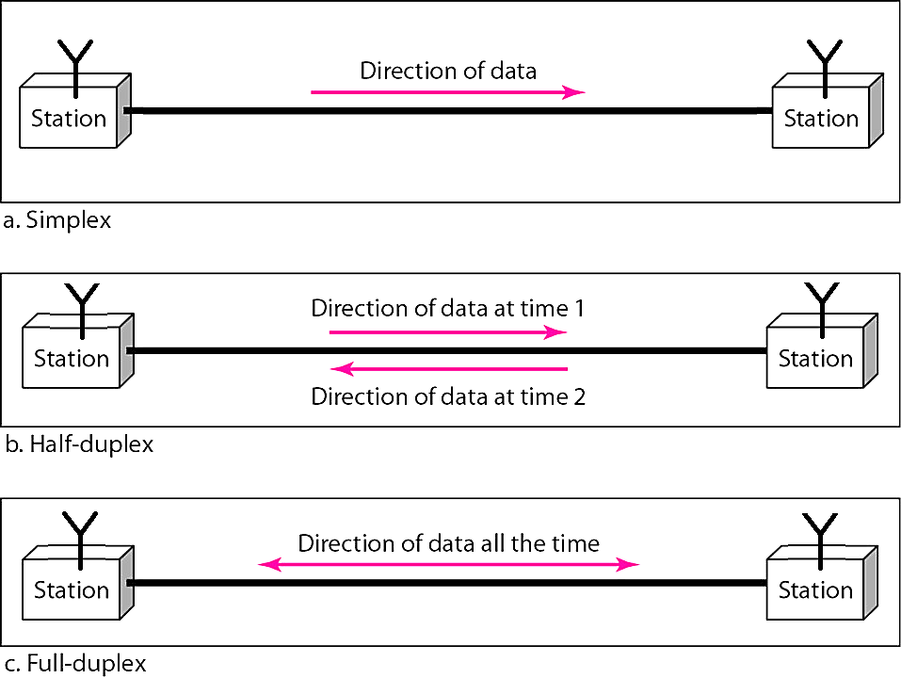
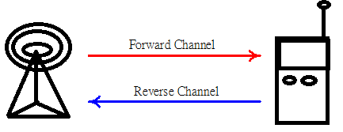
Classification of mobile radio transmission system
Simplex: communication in only one direction
Half-duplex: same radio channel for both transmission and reception (push-to-talk)
Full-duplex: simultaneous radio transmission and reception (FDD, TDD)
Frequency division duplexing uses two radio channel
Forward channel: base station to mobile user
Reverse channel: mobile user to base station
Time division duplexing shares a single radio channel in time.

Slide 23
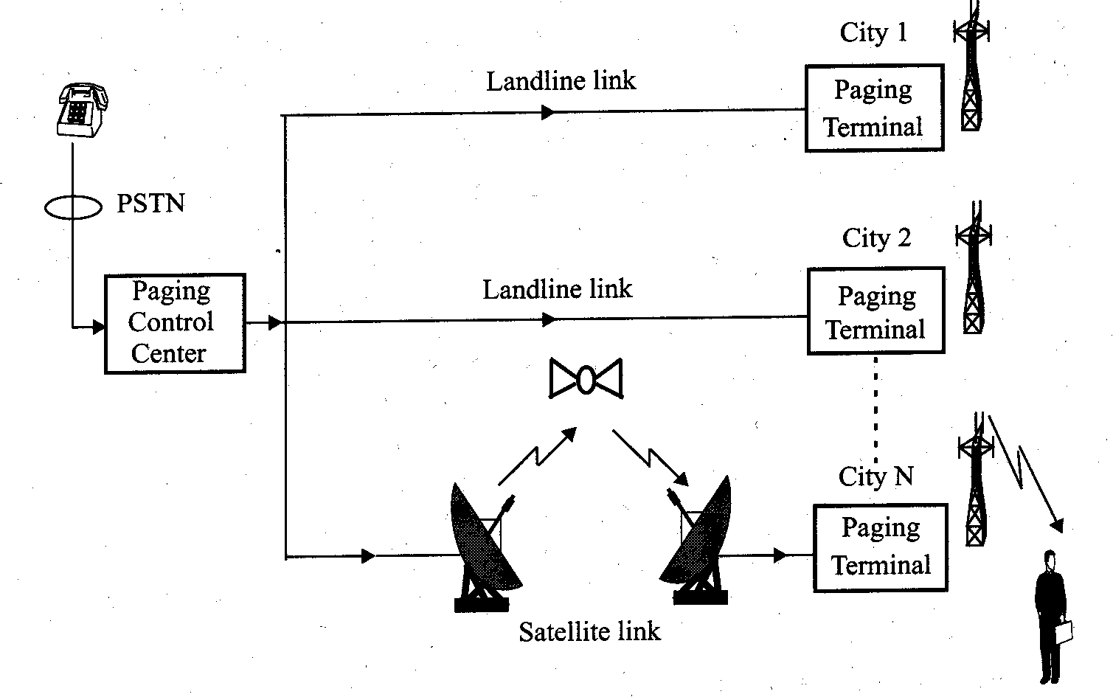
Paging Systems
Conventional paging system send brief messages to a subscriber. It is a form of simplex communication (only one way communication)
Modern paging system: news headline, stock quotations, faxes, etc.
Simultaneously broadcast paging message from each base station (simulcasting)
Large transmission power to cover wide area.
A Caller with the aid of PSTN sends a message, paging control center directs the messages with the establishment of communication to the desired paging terminal or all the paging terminals (in case of broadcast) through landline or satellite link
Source : Wireless Communications: Principles and Practice, Theodore S. Rappaport, pp12.

Slide 24
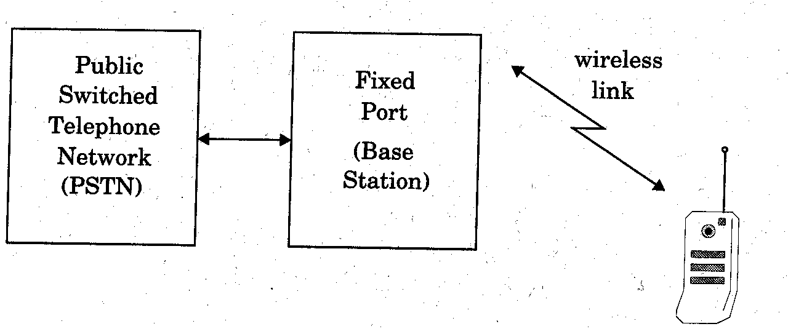
Cordless Telephone System
Cordless telephone systems are full duplex communication systems.
First generation cordless phone
in-home use
communication to dedicated base unit
few tens of meters
Second generation cordless phone
outdoor
combine with paging system
few hundred meters per station
Uses radio to connect a portable hand set to a dedicated fixed base station
The base station is then connected to a dedicated telephone line with a specific telephone number on the PSTN
When a call is dialed or received, both fixed port and portable handset (depending upon the power backup) will be connected to the PSTN.
Limited range and mobility
Source : Wireless Communications: Principles and Practice, Theodore S. Rappaport, pp13.

Slide 25
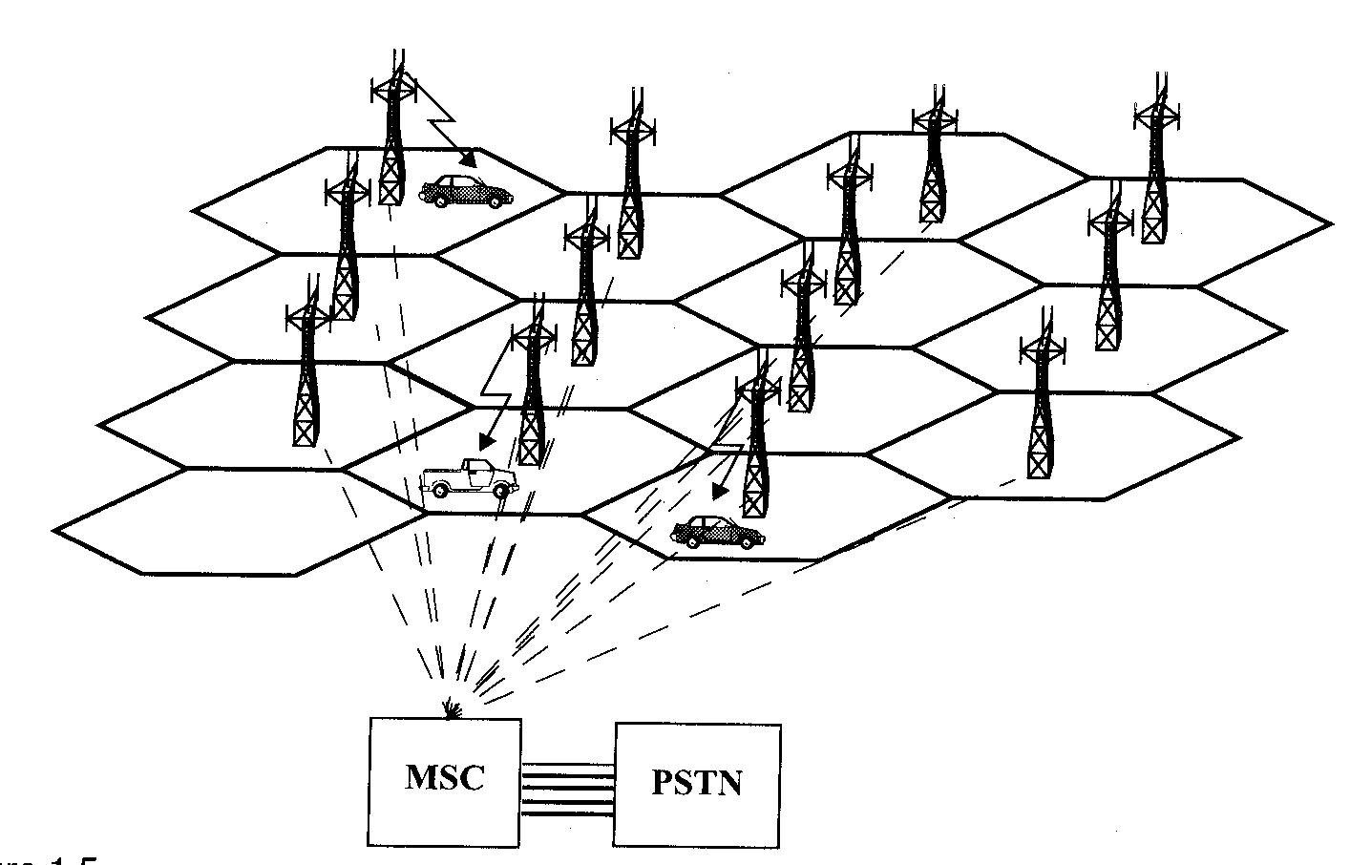
Cellular Telephone Systems
Provide connection to the PSTN for any user location within the radio range of the system.
Characteristic
Large number of users
Large Geographic area
Limited frequency spectrum
Reuse of the radio frequency by the concept of “cell’’.
Basic cellular system: mobile stations, base stations, and mobile switching center.
Source : Wireless Communications: Principles and Practice, Theodore S. Rappaport, pp14.

Slide 26
Communication between the base station and mobiles is defined by the standard common air interface (CAI)
forward voice channel (FVC): voice transmission from base station to mobile
reverse voice channel (RVC): voice transmission from mobile to base station
forward control channels (FCC): initiating mobile call from base station to mobile
reverse control channel (RCC): initiating mobile call from mobile to base station

Slide 27
Cellular Technology: Evolution
First generation:
⮚Based on analog technology, uses a single base station to
communicate with a single portable terminal.(e.g., Advance Mobile
Phone Services - AMPS)
Second generation:
⮚Based on digital modulation and advanced call processing
capabilities . (e.g., Global System for Mobile - GSM , IS-95 and
Cordless Telephone - CT2).
Third generation:
⮚To provide a single set of standards that can meet a wide range of
wireless applications (Multimedia) and provide universal access
throughout the world.(e.g., WCDMA, CDMA-2000, etc.)
Fourth generation:
⮚To enable usage over IP platform – packet switching based (e.g.,
Long Term Evolution-Advanced (LTE-A), Mobile WiMAX)

Slide 28
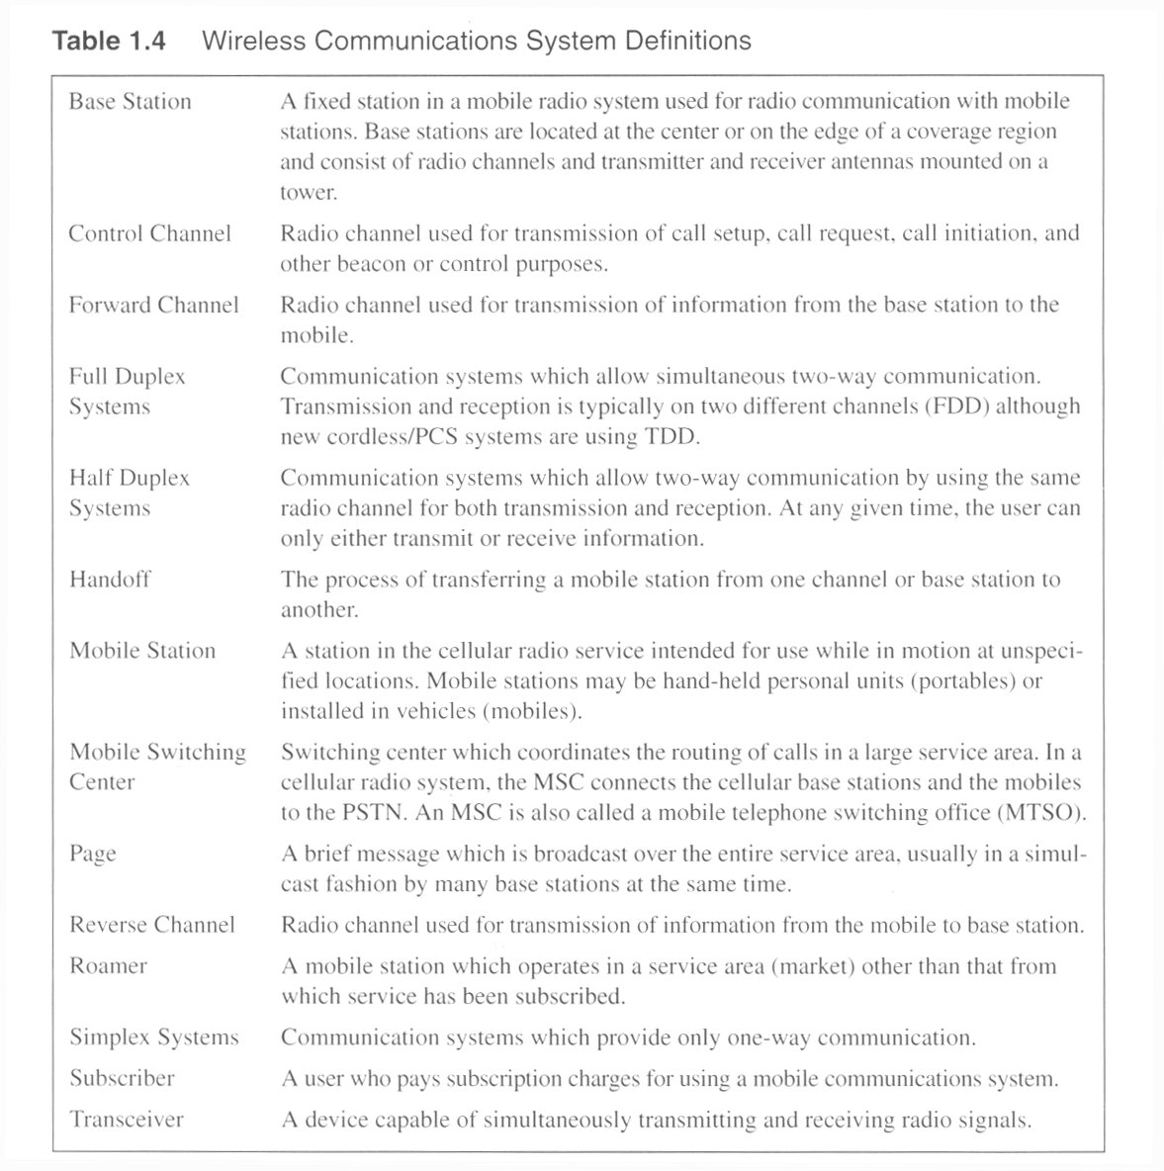
Source : Wireless Communications: Principles and Practice, Theodore S. Rappaport, pp10.

Slide 29
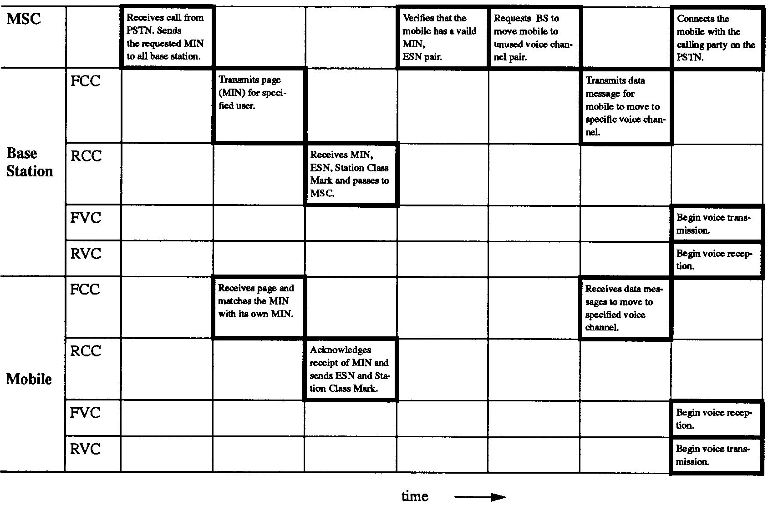
Timing diagram illustrating how a call to a mobile user initiated by a landline subscriber is established.
Source : Wireless Communications: Principles and Practice, Theodore S. Rappaport, pp16.
Notes:
Fig. 1.6

Slide 30
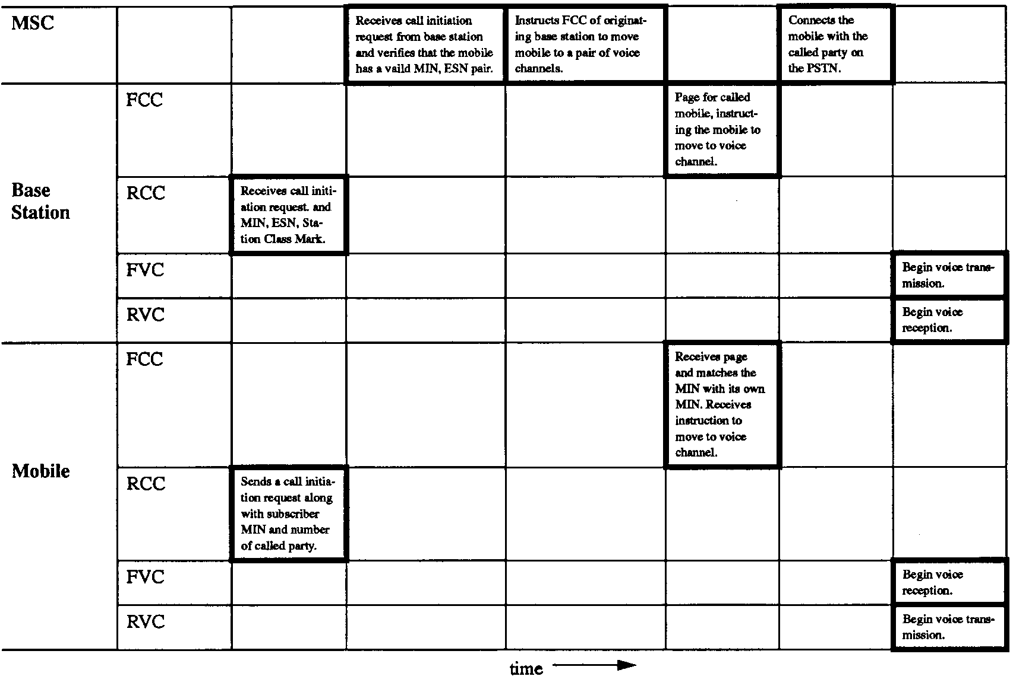
Timing diagram illustrating how a call initiated by a mobile is established
Source : Wireless Communications: Principles and Practice, Theodore S. Rappaport, pp17.
Notes:
Fig. 1.7

Slide 31
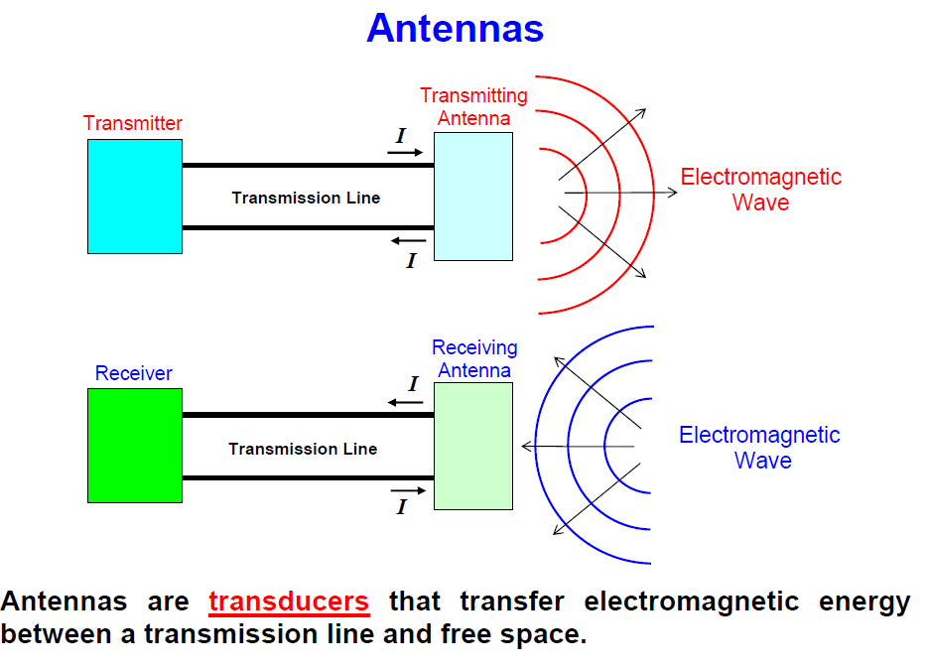

Slide 32
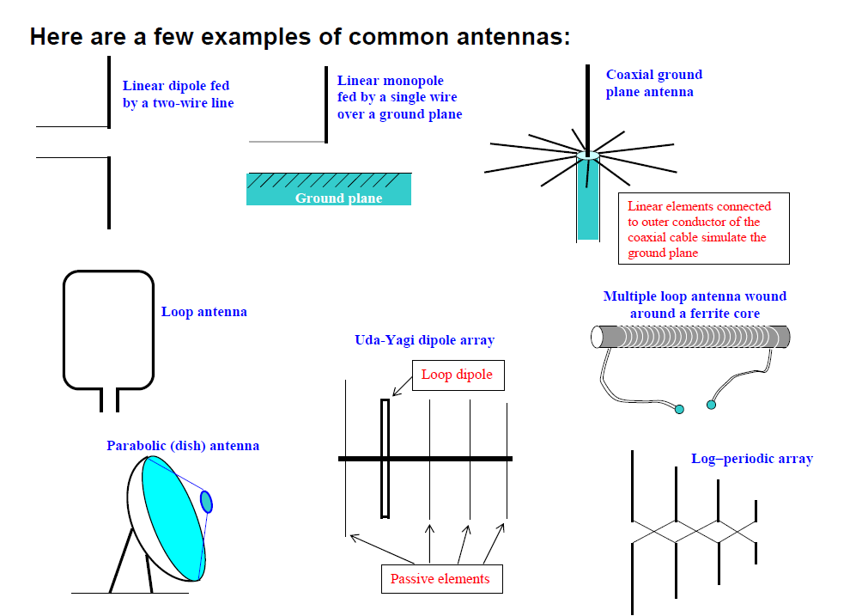

Slide 33
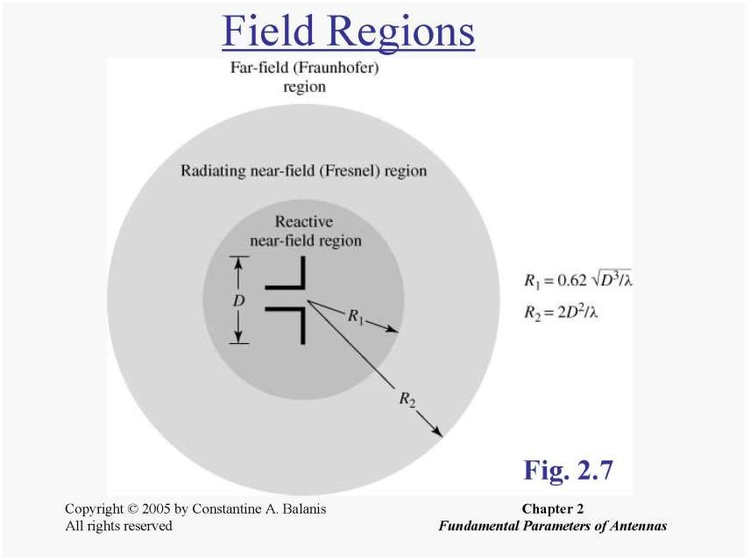

Slide 34
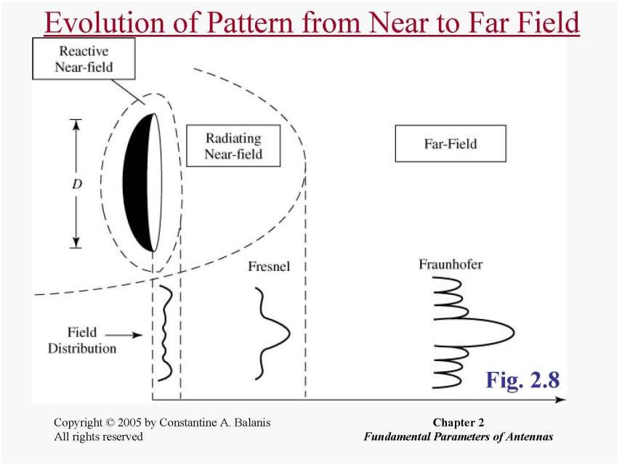

Largest dimension of the antenna
Pattern is well formed with dominant Main lobe
Patten is flat (no main lobes are formed)
Main lobe begins to develop

Slide 35
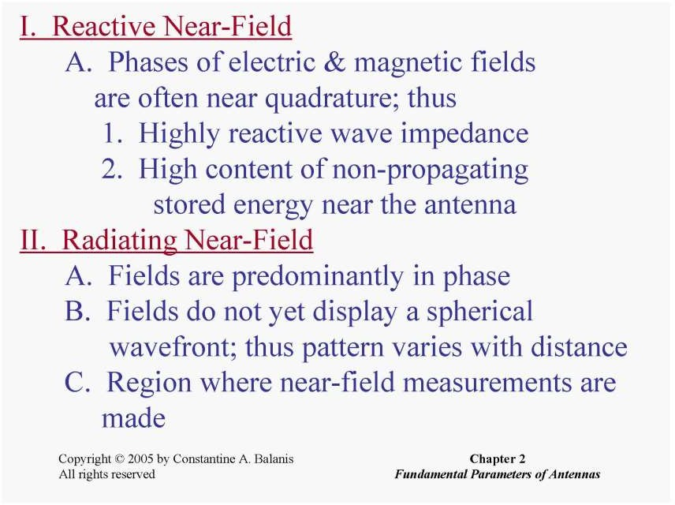
Notes:
E and H are not completely orthogonal( 90 deg but not fully)
Waves are planar and e,h are completely orthogonal in far field

Slide 36
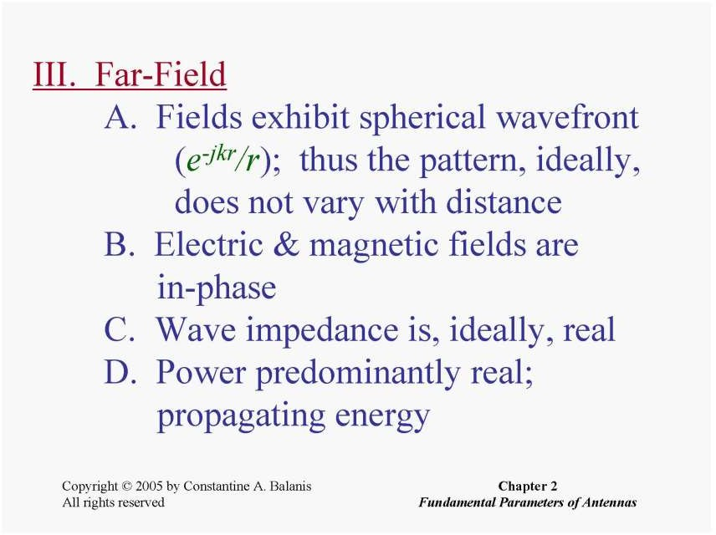


Slide 37
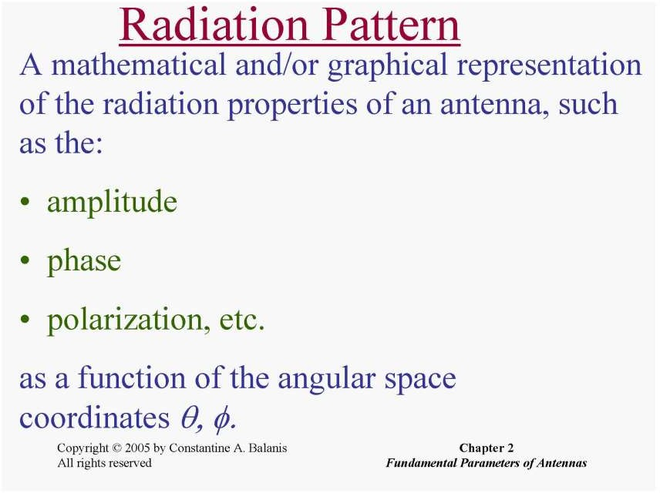

Slide 38
The beamwidth of a pattern is defined as the angular separation between two
identical points on opposite side of the pattern maximum.
Half-Power Beamwidth (HPBW ) is defined as: “In a plane containing the direction of the maximum of a beam, the angle between the two directions in which the radiation intensity is one-half value of the beam.”
The angular separation between the first nulls of the pattern is referred to as the
First-Null Beamwidth (FNBW )
Radiation intensity (W/unit solid angle) in a given direction is defined as “the power radiated from an antenna per unit solid angle.” Obtained by multiplying radiation density (in W/m²) with square of distance r.
Directivity of an antenna defined as “the ratio of the radiation intensity in a given direction from the antenna to the radiation intensity averaged over all directions.

Slide 39

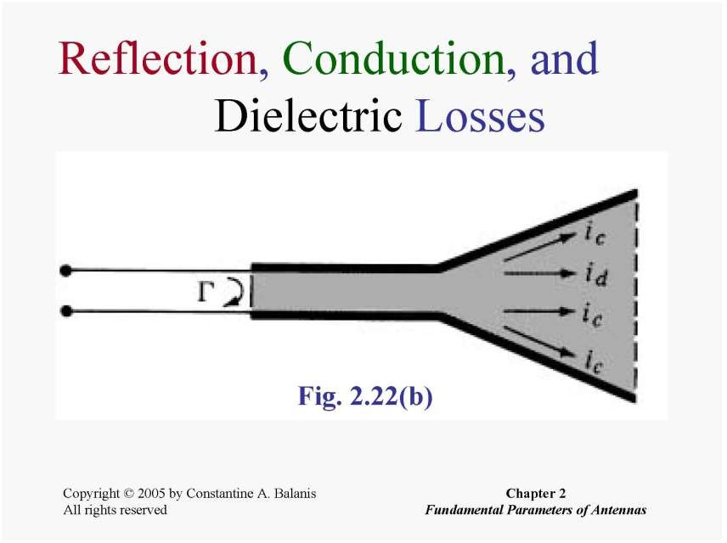
The total antenna efficiency e₀ is used to take into account losses at the input terminals and within the structure of the antenna.
reflections because of the mismatch between the transmission line and the antenna (reflection) – results in reflection coefficient
I ²R losses (conduction and dielectric – ic and id)

Slide 40
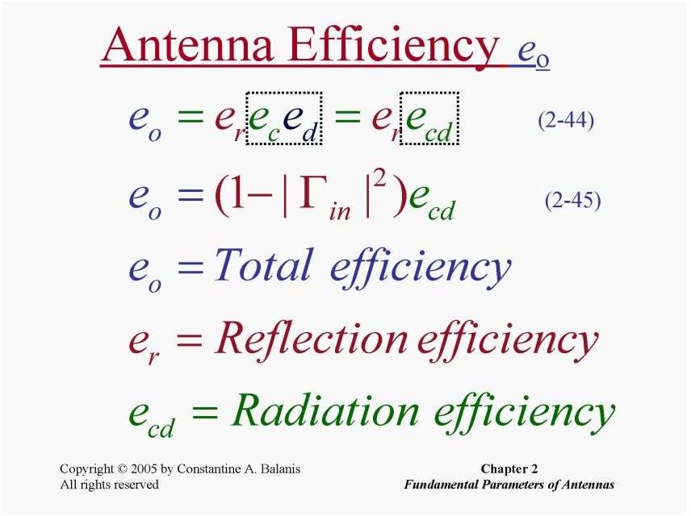

Slide 41
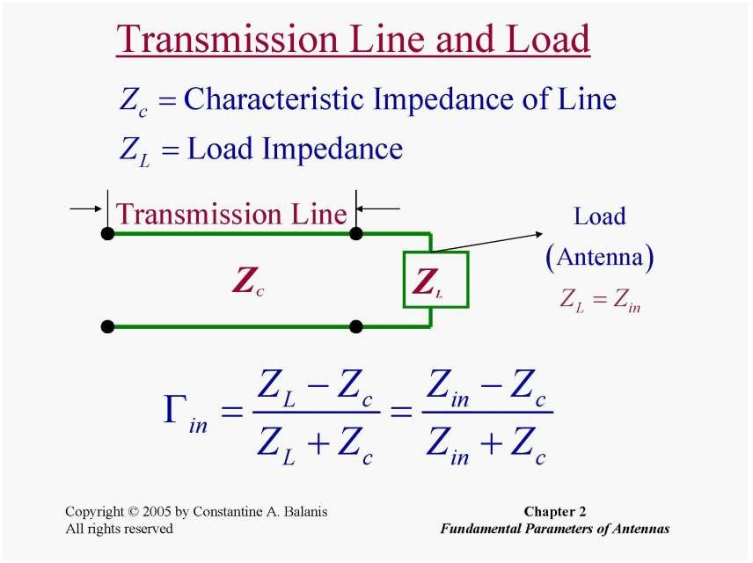

Slide 42
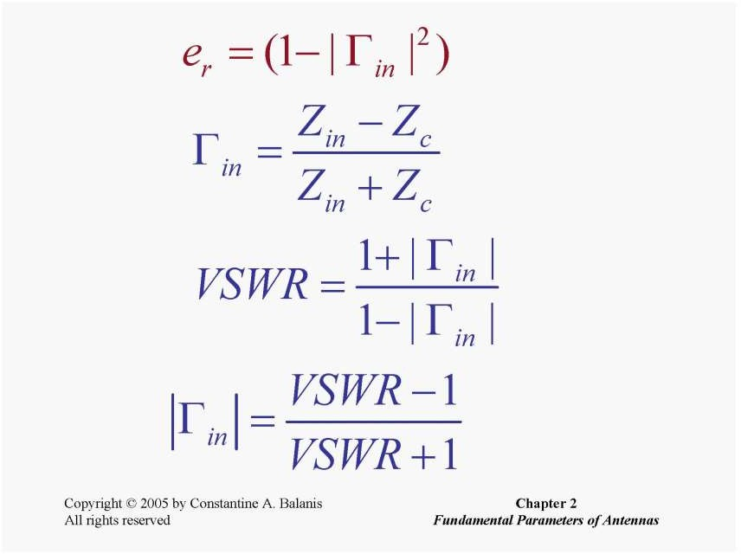

Slide 43
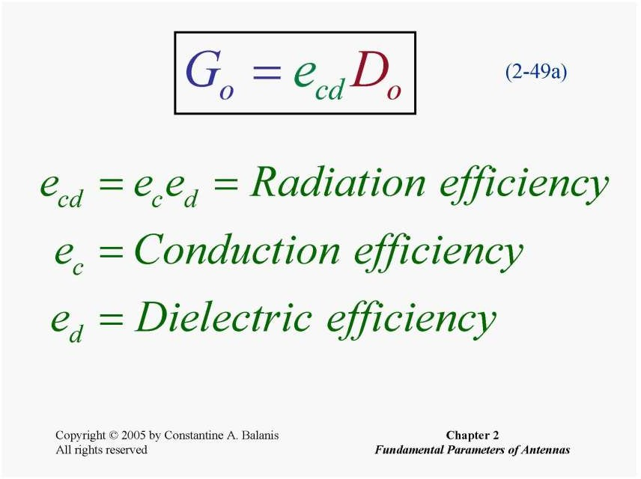
Gain of the antenna is closely related to the directivity, it is a measure that takes into account the efficiency of the antenna as well as its directional capabilities.
Directivity is a measure that describes only the directional properties of the antenna, and it is therefore controlled only by the pattern.

Slide 44
How the direction of the electric field vector changes with time at a fixed point in space.
Polarization
Linear
Circular
If the locus of the tip of the E-field is a straight line 🡪 linear polarization.
Circular locus 🡪 Circular polarization.
Elliptical locus 🡪 Elliptical polarization.
The polarization is called right-handed, if the fingers of the right hand follow the direction of rotation of the E-vector while the thumb points in the direction of propagation. Otherwise, left-handed.

Slide 45
The dipole and monopole are two of the most widely used antennas for wireless mobile communication systems
An array of dipole elements is extensively used as an antenna at the base station
The monopole, because of its broadband characteristics and simple construction, is perhaps to most common antenna element for portable equipment, such as cellular telephones, cordless telephones, automobiles, trains, etc.
An alternative to the monopole for the handheld unit is the loop. Other elements include the inverted F, planar inverted F antenna (PIFA), microstrip (patch), spiral
In cell phone devices – PIFA antennas are used in recent days and before 2G and LTE systems, Monopole antennas were used

Slide 46
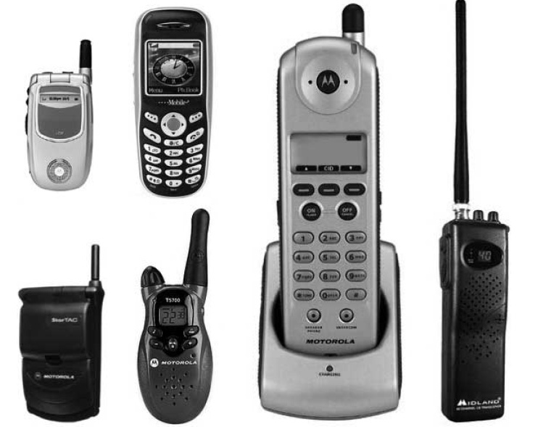
Examples of stationary, retractable/telescopic and embedded/hidden antennas used in commercial cellular and cordless telephones, walkie-talkies, and CB radios.

Slide 47
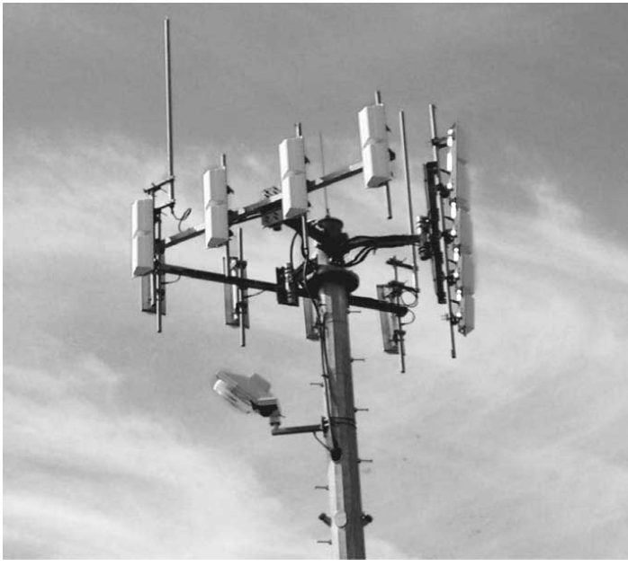
Triangular array of dipoles used as a sectoral base-station antenna for mobile Communication.

